Slide 1


2019
Department
Of Computer
Science
&
Electrical And
Electronics
Engineering
MATH-IV
KAS -402
2020-2021
Dr.Rupa Sharma
Associate Professor
vsrsrsys@gmail.com

Slide 2
Topic-11 [find the particular integral] Case -5

Slide 3

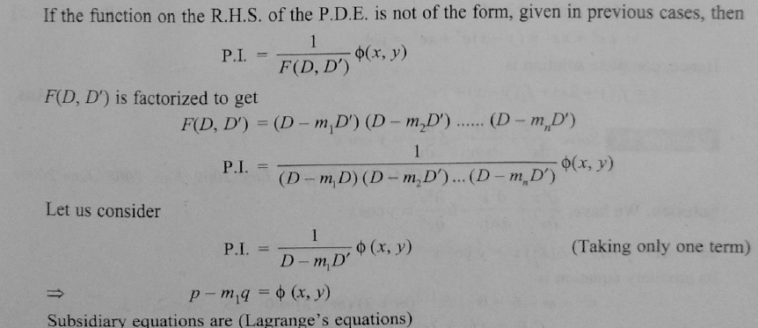

Slide 4
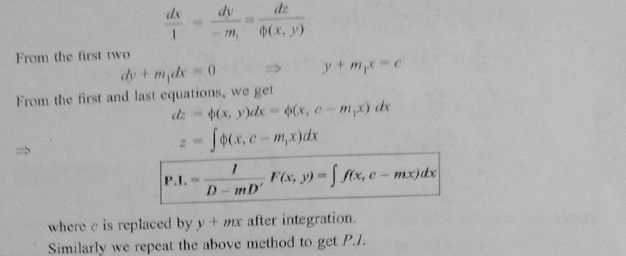

Slide 5
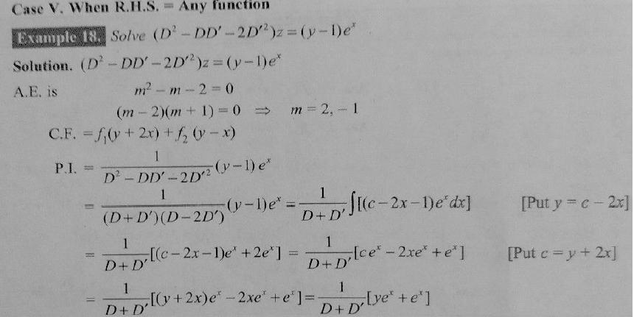

Slide 6
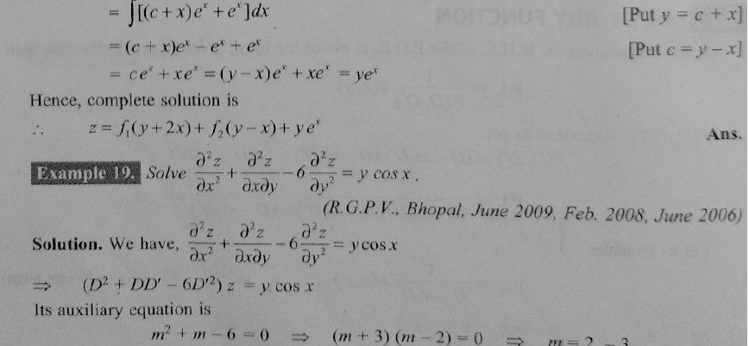

Slide 7
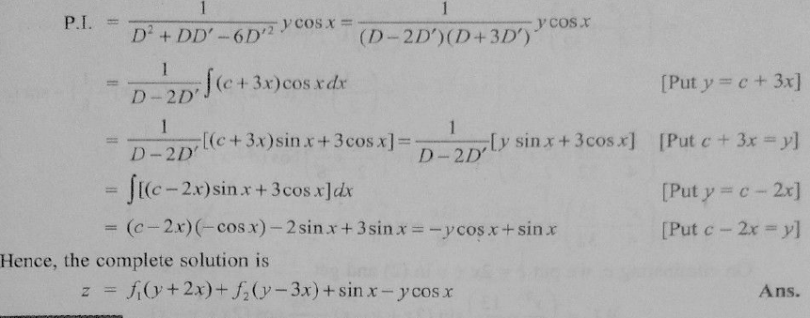

Slide 8

HOME WORK
Ans:

Slide 9
THANK YOU

